Slide 1

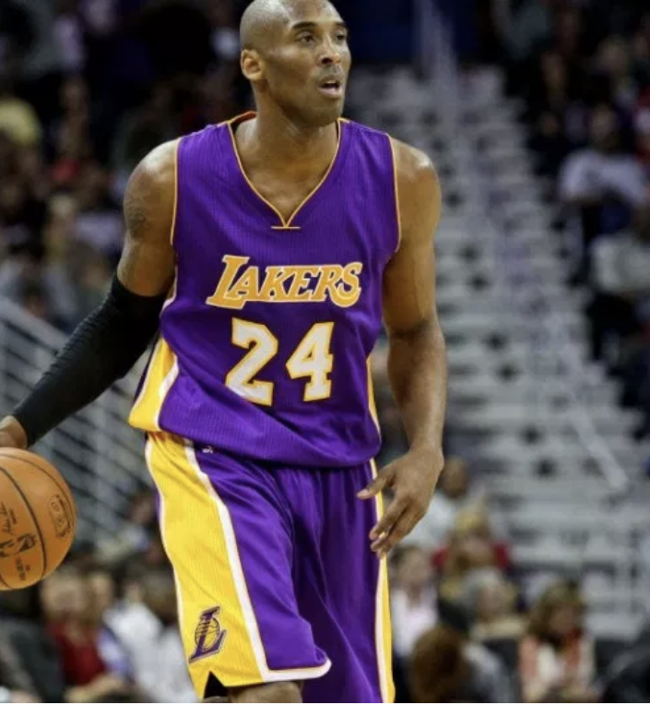

Slide 2
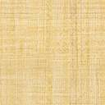
Kobe Bean Bryant , often known as Kobe, is an American former professional basketball player. He played his entire 20-year career with the Los Angeles Lakers of the National Basketball Association (NBA). He entered the NBA directly from high school and won five NBA championships. Bryant is an 18-time All-Star, 15-time member of the All-NBA Team, and 12-time member of the All-Defensive team. He led the NBA in scoring during two seasons and ranks third on the league's all-time regular season scoring and fourth on the all-time postseason scoring list. He is widely regarded as one of the greatest basketball players of all time.^{[3][4][5][6]} Bryant is the first guard in NBA history to play at least 20 seasons.
Source : https://en.wikipedia.org/wiki/Kobe_Bryant

Slide 3
Description of Data
We have data about every shot attempted by Kobe in his 20-year career which is about 25000 attempts.
The data contains 29 features. There is a mix of continuous and categorical features. The list if features are as below.
recId action_type combined_shot_type game_event_id game_id lat – court location identifier (latitude) loc_x - court location identifier (x/y axis) loc_y- court location identifier (x / y axis) lon - court location identifier (longitude) minutes_remaining – (in period) period playoffs season seconds_remaining attendance | avgnoisedb – avg noise in arena (decibels) shot_distance shot_made_flag (this is what you are predicting) shot_type shot_zone_area shot_zone_basic shot_zone_range team_id team_name game_date matchup opponent shot_id arena_temp (oF)

Slide 4
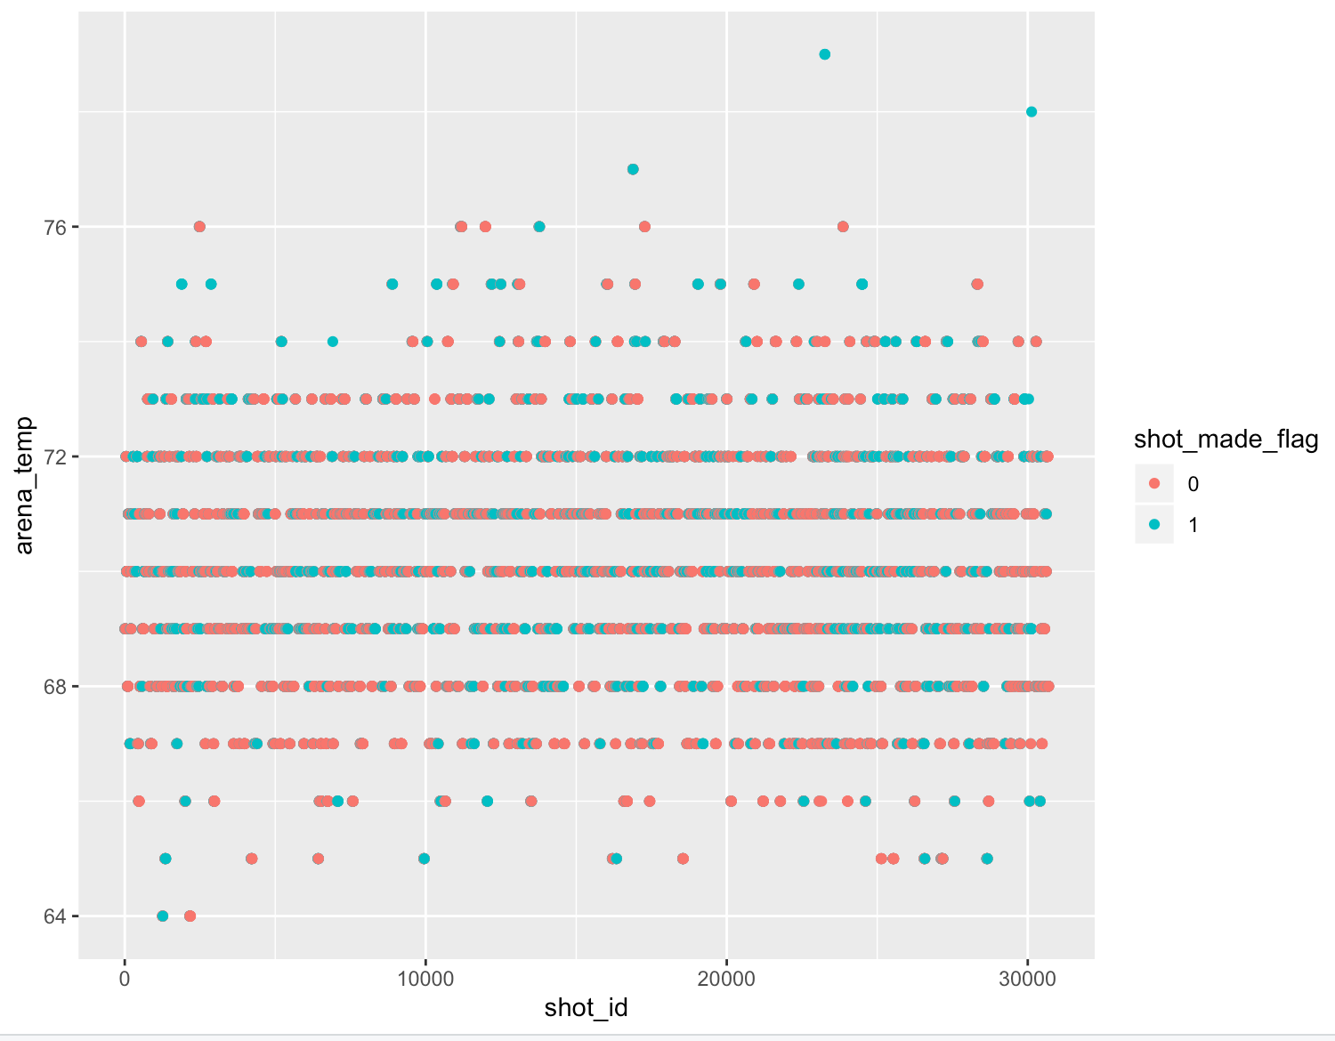
Analysis of Kobe Data Most of the shots made b/w 65 and 75 temperature

Slide 5
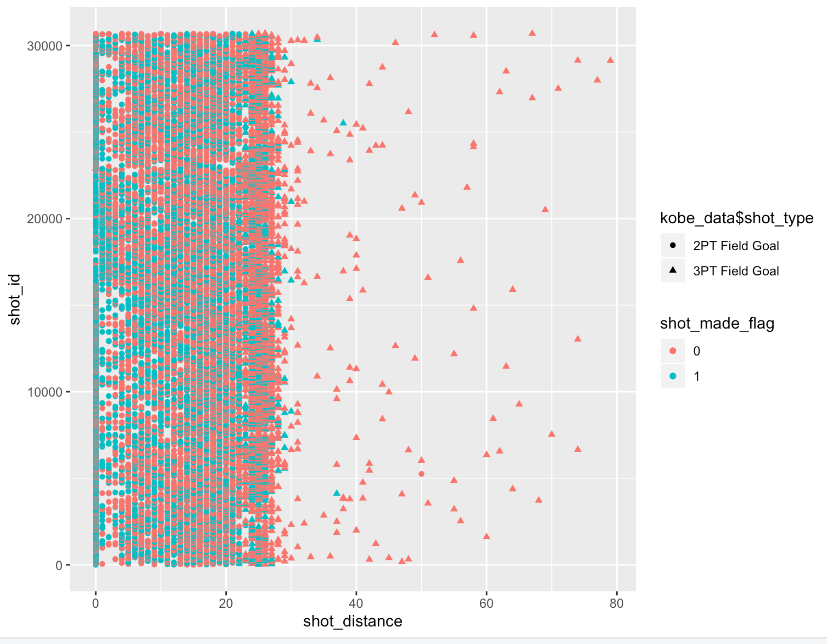
Most shots made when shot distance is below 25

Slide 6
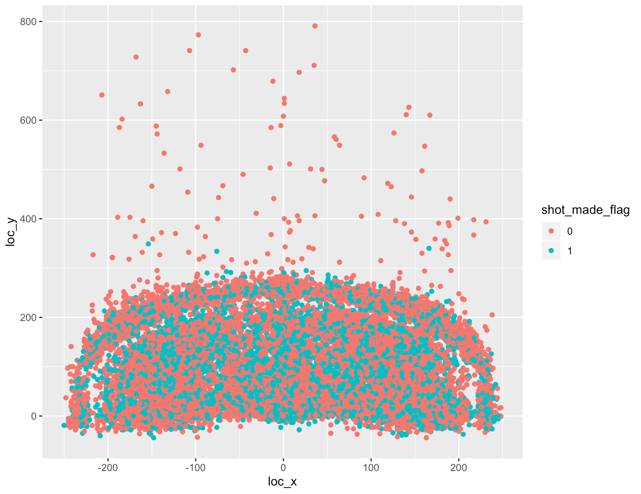
Court x-y coordinates has influence on success of shot

Slide 7
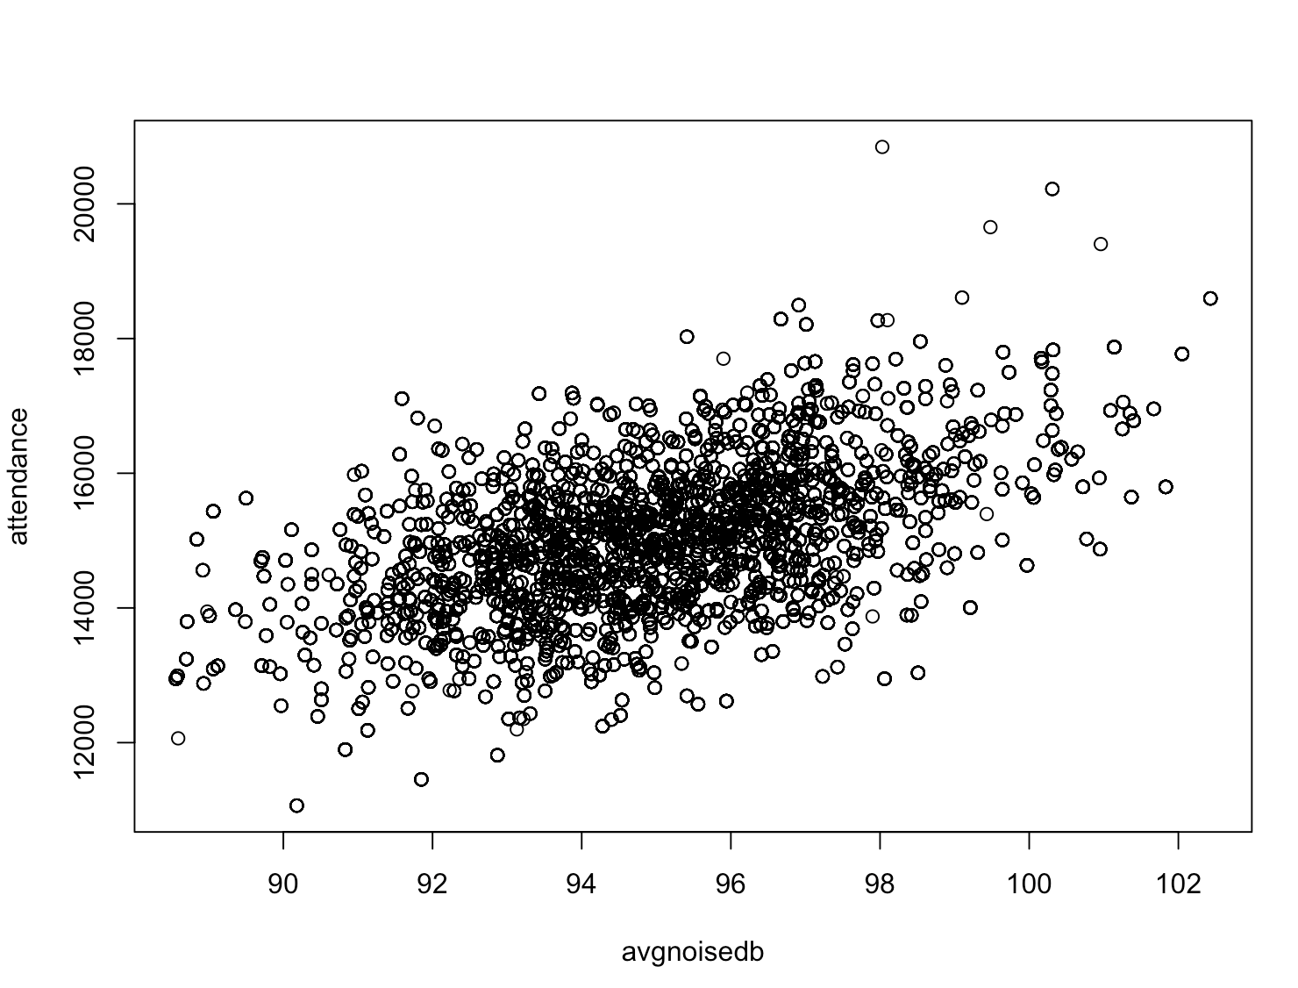
Attendence and noise has correlation

Slide 8
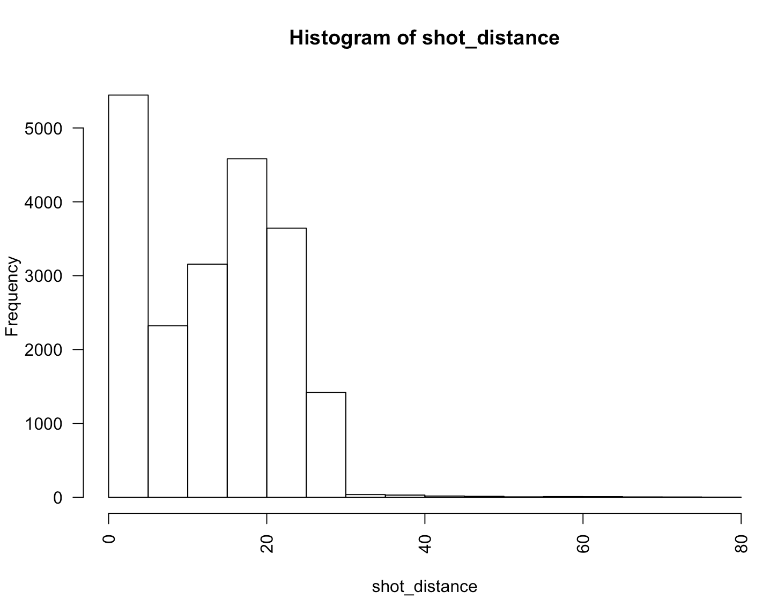
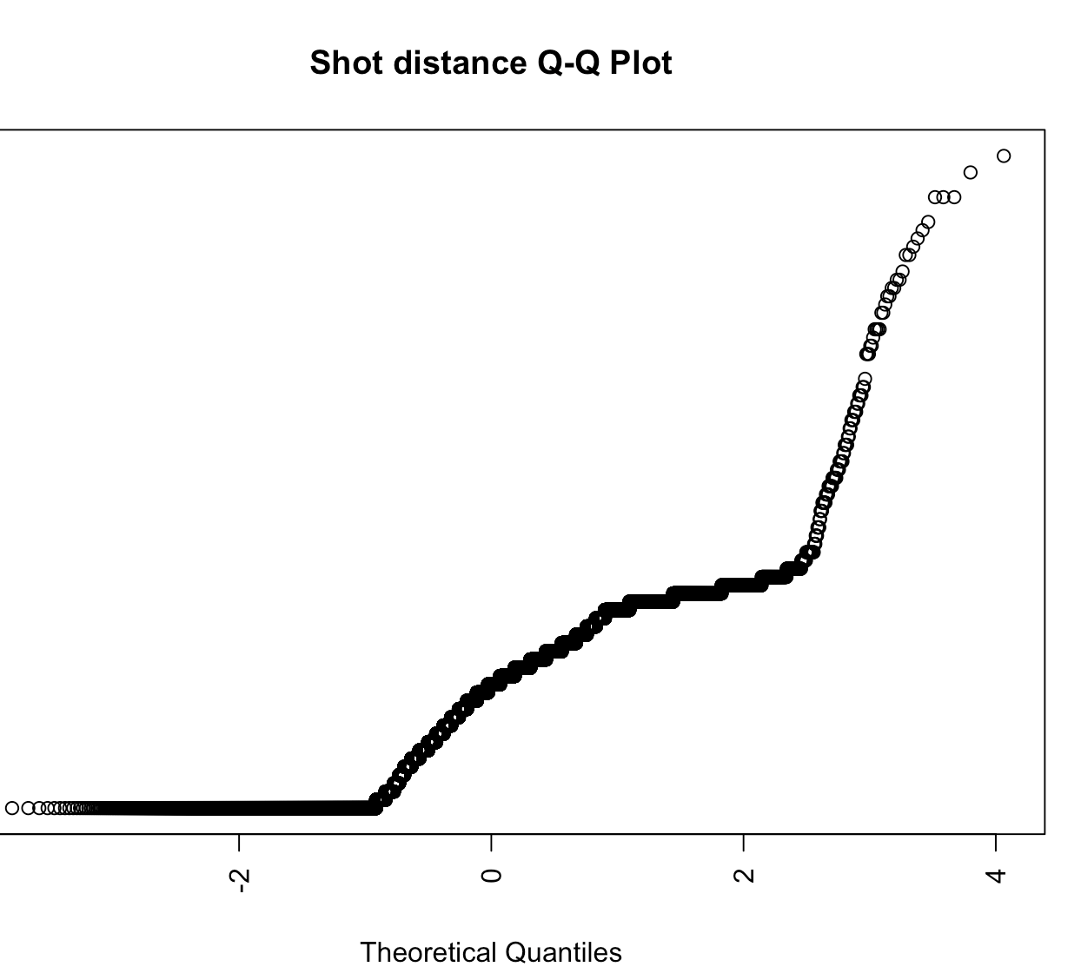
Checking for normality
Most continuous explanatory vars are normally distributed.
Shot_distance seem to have some skewed ness but most of the frequency is around zero.

Slide 9
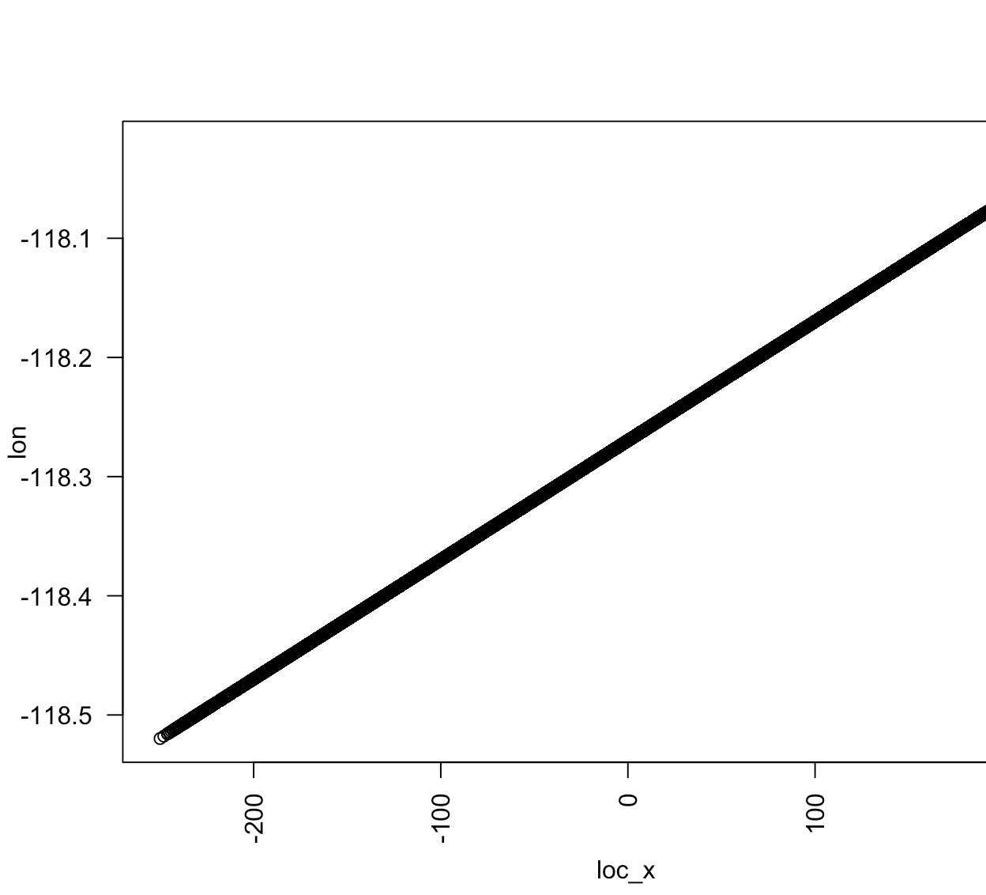
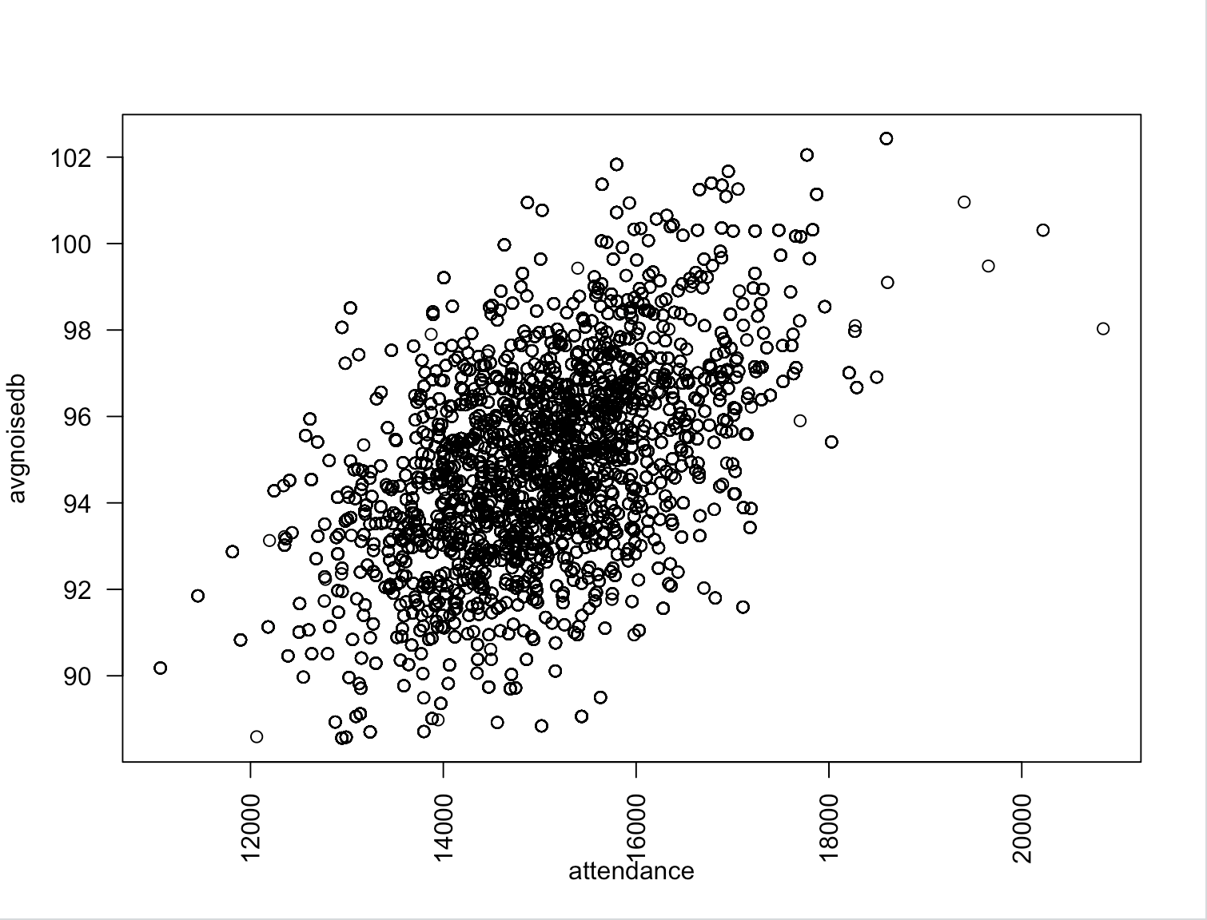
multicolinearity
Attendance and avgnoise are correlated
Loc_x and lon are correlated.

Slide 10
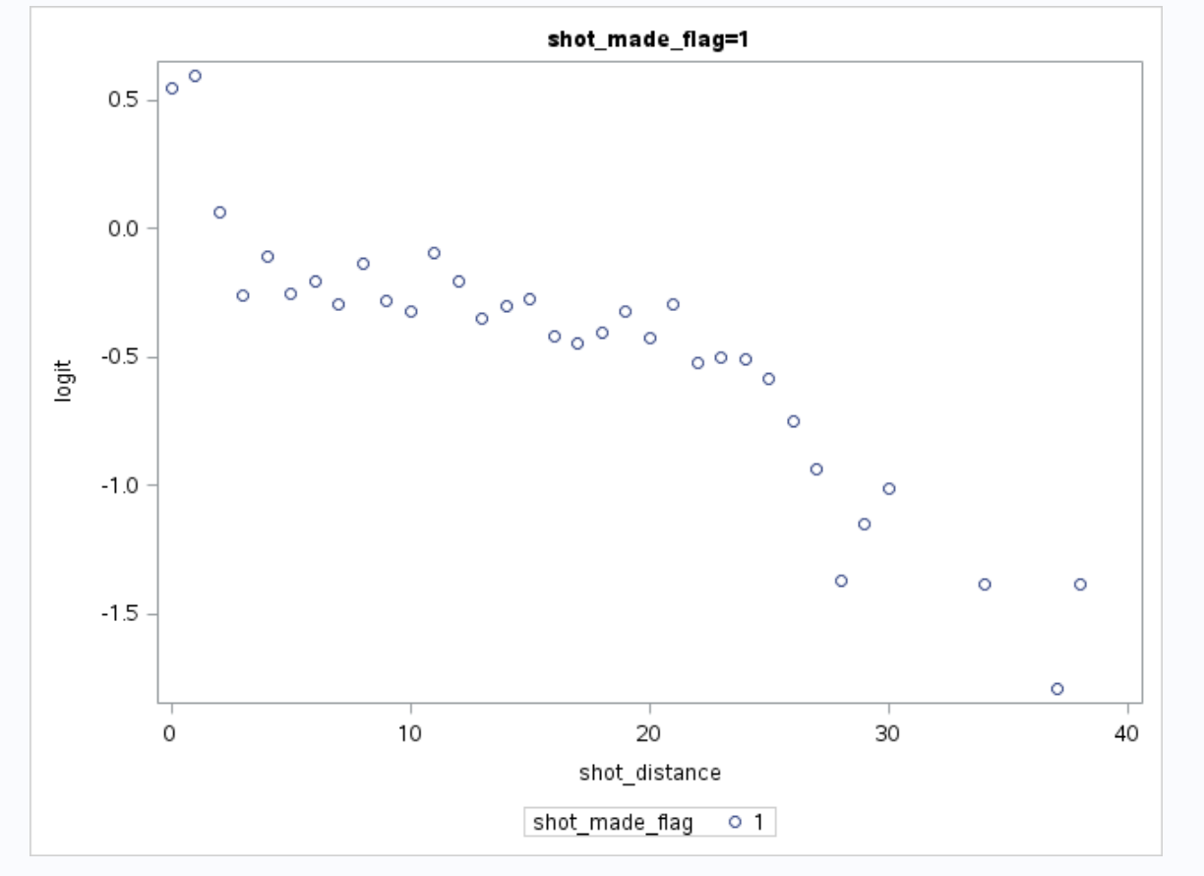
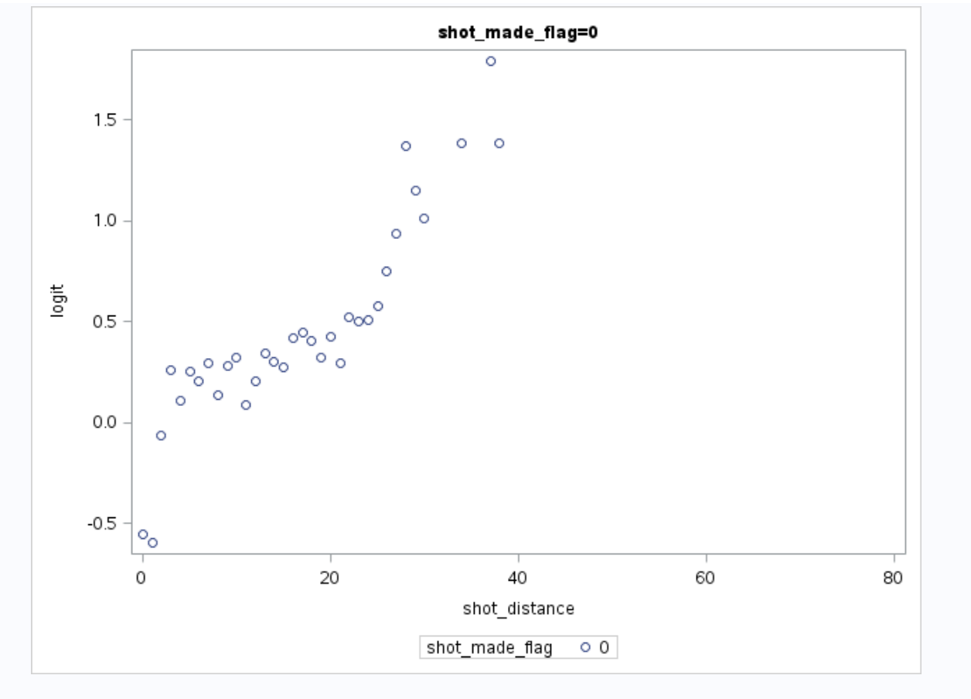
Logit variation with shot distance

Slide 11
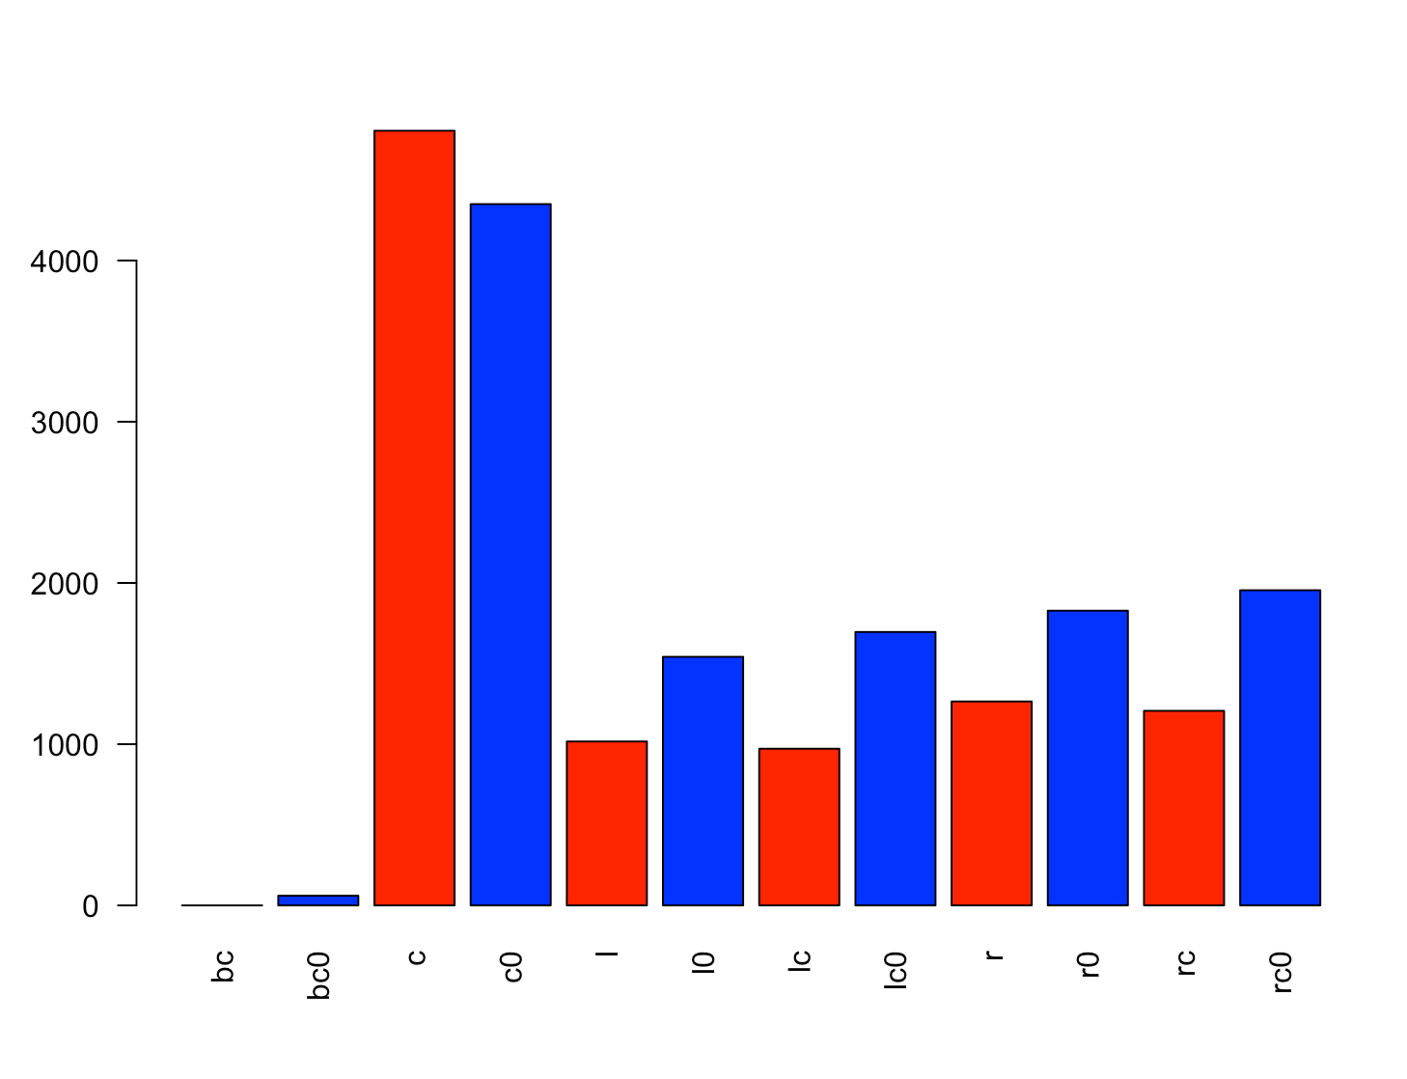
Shot made and missed by zone area
Red bars represent shot made and blue is shot missed. Center zone shots has more shots made than missed. All other areas have more missed than made. Back center (bc) is the least. Zero shot made and 60 shots missed.

Slide 12
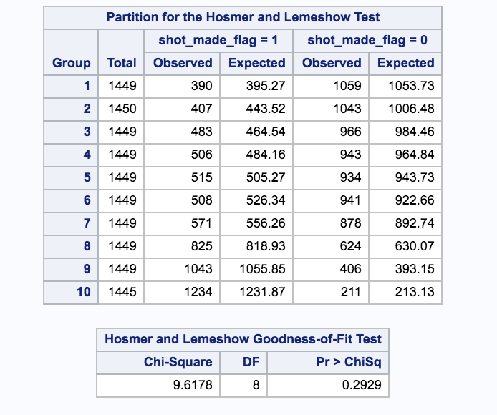
Goal : Build a Logistic model to predict the odd of successful shot
Assumptions checking for logistic regression
Included combined_shot_type, action_type, opponent and matchup into the SAS logictic model
proc logistic data=training; class shot_made_flag playoffs(ref='0') combined_shot_type shot_zone_range(ref='Less Than 8 ft.') action_type opponent matchup / param=reference; model shot_made_flag(event='1') = playoffs action_type shot_zone_range seconds_remaining avgnoisedb playoffs*shot_zone_range / selection=STEPWISE cl expb lackfit ctable outroc=troc stopres pprob=0.45 ; score data=testing fitstat outroc=vroc ; score data=testkobeshot out=results; run;

Slide 13
Goal : Build a Logistic model
Check if data honors the assumption
Using Hosmer and Lemeshow Goodness of fit test to validate the assumptions
After selecting few of the features , the goodness of fit test suggests that model is a fit.

Slide 14
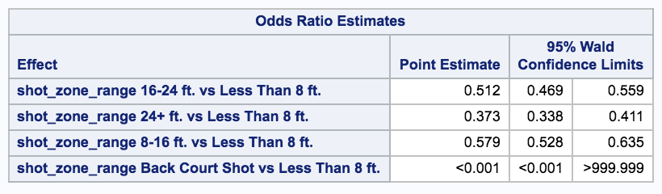
How distance to hoop affects Kobe’s shot
The odds of kobe making a successful shot if the distance from the hoop is in the range of 8-16ft is estimated to be 0.57 times that of hoop being with in 8ft range (p < 0.0001)

